Slide 1
Week 1
McGraw-Hill/Irwin
Copyright © 2010 by the McGraw-Hill Companies, Inc. All rights reserved.

Slide 2
Key Concepts and Skills
Know the basic types of financial management decisions and the role of the Financial Manager
Know the financial implications of the various forms of business organization
Know the goal of financial management
Understand the conflicts of interest that can arise between owners and managers

Slide 3
1.1 What Is Corporate Finance?
Finance addresses the following three questions:
  What long-term investments should the firm choose? – CAPITAL BUDGETING
  How should the firm raise funds for the selected investments? – CAPITAL STRUCTURE
  How should short-term assets be managed and financed? – NET WORKING CAPITAL

Slide 4
Balance Sheet Model of the Firm
  Total Value of Assets:
  Total Firm Value to Investors:
Current Assets
Current Liabilities
Long-Term Debt
Fixed Assets
1 Tangible
2 Intangible
Shareholders’ Equity

Slide 5
The Capital Budgeting Decision
Current Assets
Current Liabilities
Long-Term Debt
Fixed Assets
1 Tangible
2 Intangible
  What long-term investments should the firm choose?
Shareholders’ Equity

Slide 6
The Capital Structure Decision
Current Assets
Current Liabilities
Long-Term Debt
How should the firm raise funds for the selected investments?
Fixed Assets
1 Tangible
2 Intangible
Shareholders’ Equity

Slide 7
Short-Term Asset Management
Current Assets
Current Liabilities
Net Working Capital
Long-Term Debt
  How should short-term assets be managed and financed?
Fixed Assets
1 Tangible
2 Intangible
Shareholders’ Equity

Slide 8
The Financial Manager
The Financial Manager’s primary goal is to increase the value of the firm by:
Selecting value creating projects
Making smart financing decisions

Slide 9
Hypothetical Organization Chart
Board of Directors
Chairman of the Board and
Chief Executive Officer (CEO)
President and Chief
Operating Officer (COO)
Vice President and
Chief Financial Officer (CFO)
Treasurer
Controller
Cash Manager
Credit Manager
Tax Manager
Cost Accounting
Capital Expenditures
Financial Planning
Financial Accounting
Data Processing

Slide 10
1.2 The Corporate Firm
The corporate form of business is the standard method for solving the problems encountered in raising large amounts of cash.
However, businesses can take other forms.

Slide 11
Forms of Business Organization
The Sole Proprietorship
The Partnership
  General Partnership
  Limited Partnership
The Corporation
  Private
  Public
  Companies with more than $10 million in assets whose securities are held by more than 500 owners must file annual and other periodic reports. These reports are available to the public through the SEC's EDGAR database.
  More info: http://www.sec.gov/about/laws.shtml

Slide 12
A Comparison
Corporation
Partnership
Liquidity
Shares can be easily exchanged
Subject to substantial restrictions
Voting Rights
Usually each share gets one vote
General Partner is in charge; limited partners may have some voting rights
Taxation
Double
Partners pay taxes on distributions
Reinvestment and dividend payout
Broad latitude
All net cash flow is distributed to partners
Liability
Limited liability
General partners may have unlimited liability; limited partners enjoy limited liability
Continuity
Perpetual life
Limited life

Slide 13
Pros and cons of going public
PROS
Obtain money that does not have to be repaid
Increased visibility
Market valuation
CONS
Going public is costly
Management loses some of its freedom to act without board approval
Open to scrutiny
Public reporting
Company maybe taken over

Slide 14
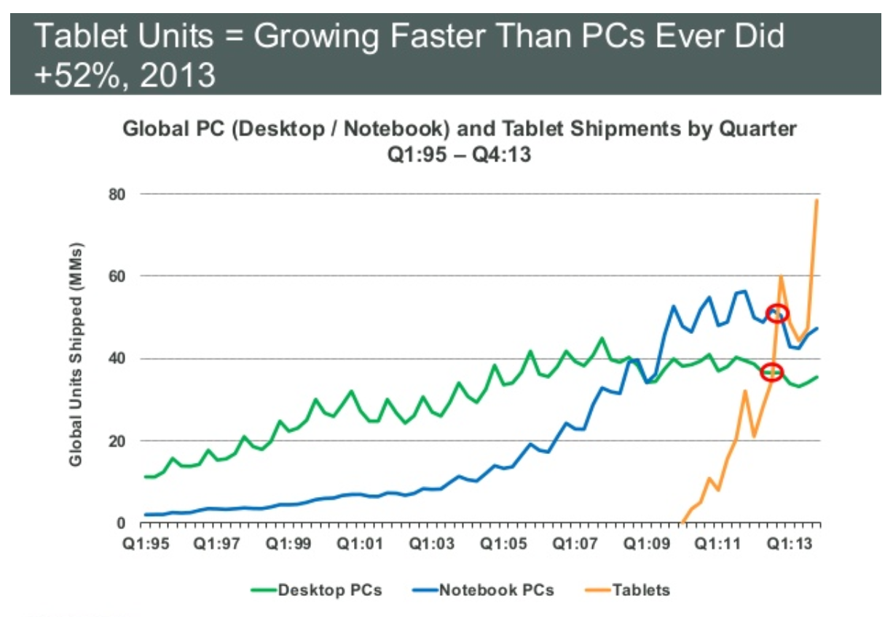
DELL

Slide 15
1.3 The Importance of Cash Flow
Firm issues securities (A)
Firm
Financial
markets
Invests
in assets
(B)
Retained
cash flows (F)
Cash flow
from firm (C)
Dividends and
debt payments (E)
Short-term debt
Long-term debt
Equity shares
Current assets
Fixed assets
Taxes (D)
The cash flows from the firm must exceed the cash flows from the financial markets.
Ultimately, the firm must be a cash generating activity.
Government

Slide 16
1.4 The Goal of Financial Management
What is the correct goal?
  Maximize profit?
  Minimize costs?
  Maximize market share?
  Maximize shareholder wealth?

Slide 17
1.5 The Agency Problem
Agency relationship
  Principal hires an agent to represent his/her interest
  Stockholders (principals) hire managers (agents) to run the company
Agency problem
  Conflict of interest between principal and agent

Slide 18
Managerial Goals
Managerial goals may be different from shareholder goals
  Expensive perquisites
  Survival
  Independence
Increased growth and size are not necessarily equivalent to increased shareholder wealth

Slide 19
Managing Managers
Managerial compensation
  Incentives can be used to align management and stockholder interests
  The incentives need to be structured carefully to make sure that they achieve their intended goal
Corporate control
  The threat of a takeover may result in better management

Slide 20
2.1 The Balance Sheet
An accountant’s snapshot of the firm’s accounting value at a specific point in time
The Balance Sheet Identity is:
Assets ≡ Liabilities + Stockholder’s Equity

Slide 21
U.S. Composite Corporation Balance Sheet
The assets are listed in order by the length of time it would normally take a firm with ongoing operations to convert them into cash.
Clearly, cash is much more liquid than property, plant, and equipment.
2010
2009
2010
2009
Current assets:
Current Liabilities:
Cash and equivalents
$140
$107
Accounts payable
$213
$197
Accounts receivable
294
270
Notes payable
50
53
Inventories
269
280
Accrued expenses
223
205
Other
58
50
Total current liabilities
$486
$455
Total current assets
$761
$707
Long-term liabilities:
Fixed assets:
Deferred taxes
$117
$104
Property, plant, and equipment
$1,423
$1,274
Long-term debt
471
458
Less accumulated depreciation
(550)
(460)
Total long-term liabilities
$588
$562
Net property, plant, and equipment
873
814
Intangible assets and other
245
221
Stockholder's equity:
Total fixed assets
$1,118
$1,035
Preferred stock
$39
$39
Common stock ($1 par value)
55
32
Capital surplus
347
327
Accumulated retained earnings
390
347
Less treasury stock
(26)
(20)
Total equity
$805
$725
Total assets
$1,879
$1,742
Total liabilities and stockholder's equity
$1,879
$1,742

Slide 22
Balance Sheet Analysis
When analyzing a balance sheet, the Finance Manager should be aware of three concerns:
    Liquidity
    Debt versus equity
    Value versus cost
    Balance Sheet does NOT include some of the most valuable things that a company has

Slide 23
Liquidity
Refers to the ease and quickness with which assets can be converted to cash—without a significant loss in value
Current assets are the most liquid.
Some fixed assets are intangible.
The more liquid a firm’s assets, the less likely the firm is to experience problems meeting short-term obligations.
Liquid assets frequently have lower rates of return than fixed assets.

Slide 24
Debt versus Equity
Creditors generally receive the first claim on the firm’s cash flow.
Shareholder’s equity is the residual difference between assets and liabilities.

Slide 25
Value versus Cost
Under Generally Accepted Accounting Principles (GAAP), audited financial statements of firms in the U.S. carry assets at cost.
Market value is the price at which the assets, liabilities, and equity could actually be bought or sold, which is a completely different concept from historical cost.

